Slide 1
CENG 477 Introduction to Computer Graphics
Modeling Transformations

Slide 2

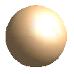

Modeling Transformations
Model coordinates to World coordinates:
World coordinates:
All shapes with their
absolute coordinates
and sizes.
y_{world}
Model coordinates:
All shapes with their
local coordinates
and sizes.
x_{world}
z_{world}

Slide 3
Basic Geometric Transformations
Used for modelling, animation as well as viewing
What to transform?
We typically transform the vertices (points) and vectors describing the shape (such as the surface normal)
This works due to the linearity of transformations
Some, but not all, transformations may preserve attributes like sizes, angles, ratios of the shape

Slide 4
Translation
Simply move the object to a relative position
P'
T
P

Slide 5
Rotation
A rotation is defined by a rotation axis and a rotation angle
For 2D rotation, the parameters are rotation angle (θ) and the rotation point (x_{r}, y_{r})
We reposition the object in a circular path around the rotation point (pivot point)
y_{r}
a
x_{r}

Slide 6
Rotation
P'
When (x_{r}, y_{r})=(0,0) we have:
r
P
The original coordinates are:
Substituting them in the
first equation we get:
In the matrix form we have:

Slide 7
Rotation
Rotation around an arbitrary point (x_{r}, y_{r})
These equations can be written as matrix operations (we will see when we discuss homogeneous coordinates)
P'
r
P
(x_{r},y_{r})

Slide 8
Scaling
Changes the size of an object
Input: scaling factors (s_{x}, s_{y})
P'
P
non-uniform vs.
uniform scaling

Slide 9
Homogenous Coordinates
Translation is additive, rotation and scaling is multiplicative (and additive if you rotate around an arbitrary point or scale around a fixed point)
We use homogenous coordinates to represent larger family of transformations, in particular including translation
Goal: Make all transformations as matrix operations
Solution: Add a third dimension

Slide 10
Homogenous Coordinates
In HC, each point now becomes a line
The entire line represents the same point
The original (non-homogeneous) point resides on the w=1 plane
w
y
p₂
p₁
w = 1
x

Slide 11
Transformations in HC
Translation:
Rotation:
Scaling:

Slide 12
Composite Transformations
Often, objects are transformed multiple times
Such transformations can be combined into a single composite transformation
E.g. Application of a sequence of transformations to a point:
Composing one single matrix is advantageous ‘cos you will be applying the same matrix to all model points.
Instead of multiplying many matrices for each model point, pre-multiply only once: Made possible thanks to the homogenous coordinates ☺.

Slide 13
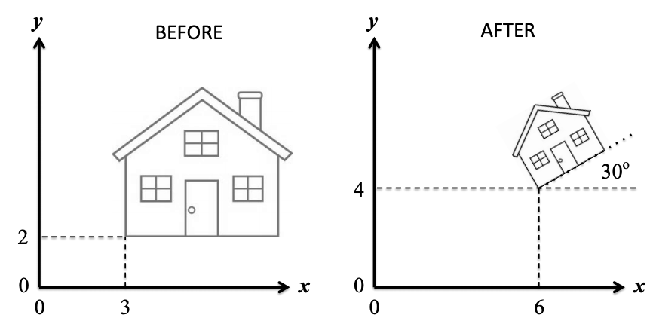
Composite Transformations
Composition of same representation of transformations is simple
Translate to origin, scale, rotate, translate back to desired point.

Slide 14
Composite Transformations
Composition of same representation of transformations is simple
E.g. translation:

Slide 15
Composite Transformations
Rotation and scaling are similar:

Slide 16
Rotation Around a Pivot Point
Step 1: Translate the object so that the pivot point moves to the origin

Slide 17
Rotation Around a Pivot Point
Step 2: Rotate around origin

Slide 18
Rotation Around a Pivot Point
Step 3: Translate the object so that the pivot point is back to its original position

Slide 19
Rotation Around a Pivot Point
The composite transformation is equal to their successive application:

Slide 20
Scaling w.r.t. a Fixed Point
The idea is the same:
Translate to origin
Scale
Translate back

Slide 21
Order of matrix compositions
Matrix composition is not commutative. So, be careful when applying a sequence of transformations.
Pivot
Pivot
1
2
2
1
Rotation and translation
Translation and rotation

Slide 22
Other Transformations
Reflection: special case of scaling

Slide 23
Other Transformations
Shear: Deform the shape like shifted slices (or deck of cards). Can be in x or y direction
(0,1)
(1,1)
(2,1)
(3,1)

Slide 24
3D Transformations
Similar to 2D but with an extra z component
We assume a right handed coordinate system
With homogeneous coordinates we have 4 dimensions
Basic transformations: Translation, rotation, scaling
z
y
x
y
x
z
x
z
y
Equivalent ways of thinking about a right-handed CS

Slide 25


Translation
Move the object by some offset:
y
x
z
y
x
z

Slide 26



Rotation
Rotation around the coordinate axes
Positive angles represent counter-clockwise (CCW) rotation when looking along the positive half towards origin
y
y
y
y
y
y
x
x
x
x
x
x
z
z
z
z
z
z
x-axis
y-axis
z-axis

Slide 27
Rotation Around Major Axes
Around x:
Around y:
Around z:

Slide 28



Rotation Around a Parallel Axis
Rotating the object around a line parallel to one of the axes: Translate to axis, rotate, translate back
E.g. rotate around a line parallel to x-axis:
y
y
y
y
x
(y_{p}, z_{p})
x
x
x
z
z
z
z
Translate
Rotate
Translate back

Slide 29

Rotation Around an Arbitrary Axis
Step 1: Translate the object so that the rotation axis passes though the origin
Step 2: Rotate the object so that the rotation axis is aligned with one of the major axes
Step 3: Make the specified rotation
Step 4: Reverse the axis rotation
Step 5: Translate back
y
x
z

Slide 30
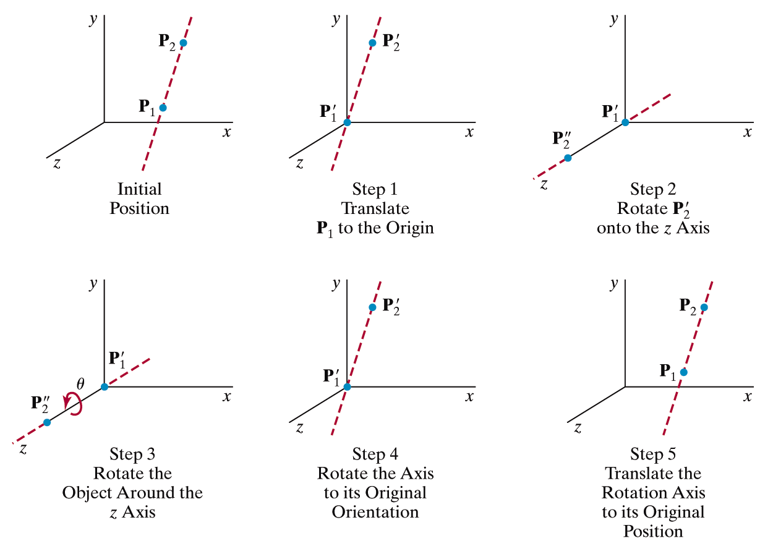
Rotation Around an Arbitrary Axis

Slide 31
Rotation Around an Arbitrary Axis
First determine the axis of rotation:
u is the unit vector along v:

Slide 32
Rotation Around an Arbitrary Axis
Next translate P₁ to origin:

Slide 33
Rotation Around an Arbitrary Axis
Then align u with one of the major axis (x, y, or z)
This is a two-step process:
Rotate around x to bring u onto xz plane
Rotate around y to align the result with the z-axis
y
y
u
α
x
x
β
u
z
z
We need cosine and sine of angles α and ß

Slide 34
Rotation Around an Arbitrary Axis
We need cosine and sine of angles α and ß:
y
u_{y}
u = u_{x} + u_{y} + u_{z} = u_{x} + u’
b
u'
u
α
x
u_{x}
c
u_{z}
z

Slide 35
Rotation Around an Arbitrary Axis
We need cosine and sine of angles α and ß:
y
u_{x}
x
β
z
u
(via R_{x}(α))
As u rotates on xz plane, its shadow on yz plane, i.e., u’, rotates simultaneously to z axis, hence the z-component (depth) of u is obtained as

Slide 36
Rotation Around an Arbitrary Axis
Putting it all together:
This is the actual desired
rotation. Other terms are
for alignment and undoing
the alignment

Slide 37
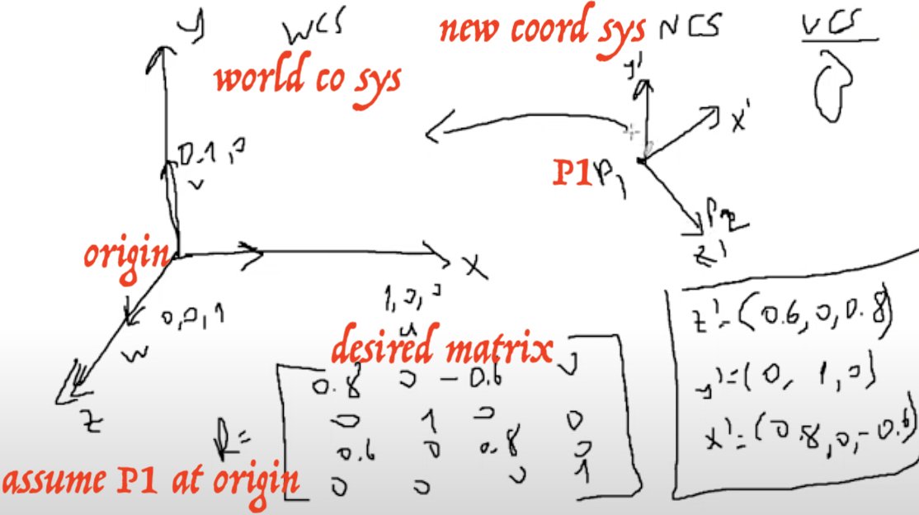
Alternative Method
Assume we wanna rotate around
the unit vector u:
We create an orthonormal basis (ONB) uvw:
To find v, set the smallest (abs)
component of u to zero and
swap the other two while
negating one:
y
y
u
v
u
E.g. if u = (a, b, c) with c
being the smallest value
then v = (-b, a, 0)
x
x
w = u x v
z
w
z
Note that we are just finding one of the infinitely many solutions

Slide 38
Alternative Method
Now rotate uvw such that it aligns with xyz: call this transform M
Rotate around x (u is now x)
Undo the initial rotation: call this M⁻¹
Finding M⁻¹ is trivial:
Verify that this matrix transforms x to u, y to v, and z to w

Slide 39
Alternative Method
Finding M is also trivial as M⁻¹ is an orthonormal matrix (all rows and columns are orthogonal unit vectors)
For such matrices, inverse is equal to transpose:

Slide 40


Alternative Method
The final rotation transform is:
We assumed that the origin of uvw is the same as the origin of xyz
Otherwise, we should account for this difference:
$$M^{−1}R_{x}(θ)M$$
$$T^{−1}M^{−1}R_{x}(θ)MT$$
Undo the
translation
Translate the origin
of uvw to xyz

Slide 41

Scaling
Change the coordinates of the object by scaling factors
y
x
z
y
x
z

Slide 42


Scaling w.r.t. a Fixed Point
Translate to origin, scale, translate back
y
y
x
y
y
x
x
x
z
z
z
z
Translate
Scale
Translate back

Slide 43



Reflection
Reflection over the major planes:
y
y
y
How about reflection over an arbitrary plane?
x
x
x
z
z
z
Notes:
Step 1: Translate a point that is on the plane to the origin
Step 2: Rotate the plane normal such that it coincides with a major axis (e.g. z-axis)
Step 3: Reflect the object over the xy-plane
Step 4: Undo step 2
Step 5: Undo step 1

Slide 44


Transforming Normals
When we transform an object, what happens to its normals?
Do they get transformed by the same matrix or does it require a different one?
y
Scale by:
y
$$n=\left[\begin{aligned}1/√2 \\ 1/√2 \\ 0\end{aligned}\right]$$
$$n=\left[\begin{aligned}3/√2 \\ 1/√2 \\ 0\end{aligned}\right]$$
1
1
1
x
3
x

Slide 45
Transforming Normals
After the transformation the normal is no longer perpendicular to the object
Also it is not a unit vector anymore
y
Scale by:
y
$$n=\left[\begin{aligned}1/√2 \\ 1/√2 \\ 0\end{aligned}\right]$$
$$n=\left[\begin{aligned}3/√2 \\ 1/√2 \\ 0\end{aligned}\right]$$
1
1
1
x
3
x

Slide 46
Transforming Normals
Rotation and translation has no problems
But, since all transformations are combined into a single matrix M, we should consider the general case.
We must have n.(b-a) = n.v = 0 and this relationship should be preserved after the transformation
n
v
b
a

Slide 47
Transforming Normals
That is n.v = 0 and n'.v' = 0 where v' = Mv and n' = Zn
Z is the matrix we are looking for
How to compute Z?
n
v
b
a

Slide 48
Transforming Normals
n.v = n^{T}v = 0
n'.v' = n'^{T}v' = n'^{T} Mv = n^{T}Z^{T}Mv = 0
If Z^{T}M = I (identity) the relationship will be preserved
So Z = (M⁻¹)^{T}
Note that this is equal to (M^{T})⁻¹ as (M⁻¹)^{T}= (M^{T})⁻¹ for a square (n by n) matrix M
n
v
b
a

Slide 49
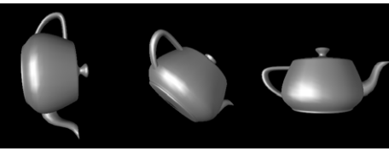
Quaternions
Another way to represent rotations
4D numbers: (a, b, c, d)
More advantageous over 3x3 rotation matrices
Less storage space (4 vs. 3x3=9)
Concatenation of quaternions requires fewer operations
Easily interpolated for smooth animations

Slide 50
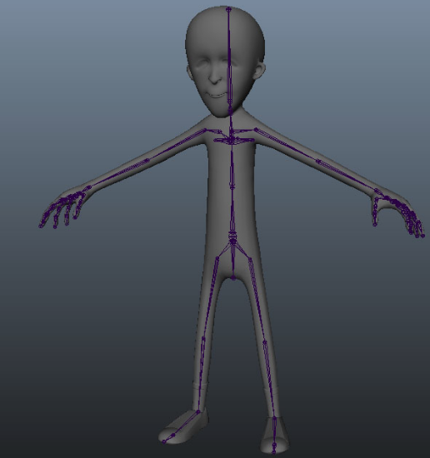
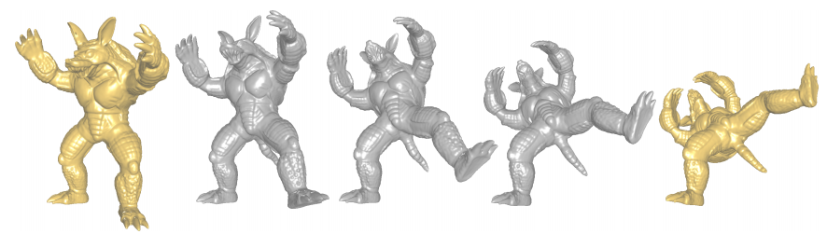
Quaternions
Another way to represent rotations
4D numbers: (a, b, c, d)
More advantageous over 3x3 rotation matrices
Less storage space (4 vs. 3x3=9)
Concatenation of quaternions requires fewer operations
Easily interpolated for smooth animations
Articulated interpolation achieved after segmenting the object into rigid parts and rigging them

Slide 51
Quaternions
Another way to represent rotations
Invented by Hamilton in 1843
He was trying to extend complex numbers
a + bi where i² = -1
(a + bi)(c + di) = (ac - bd) + (ad + bc)i
a + bi + cj //not work because dealing with ij unknown
a + bi + cj + dk //solves problem above as ij=k, jk = i, ki=j, ji=-k, ik=-j, kj=-i, and i² = j² = k² = -1
i
j
k

Slide 52
Quaternions
a + bi + cj + dk = (a, v) where vector v = <b,c,d>
q₁ = (a₁, v₁), q₂ = (a₂, v₂)
It looks like an angle a and a rotation axis v
q₁ + q₂ = (a₁ + a₂, v₁ + v₂)
q₁q₂ = (a₁, b₁i + c₁j + d₁k) (a₂, b₂i + c₂j + d₂k)
= (a₁ a₂ - v₁.v₂, a₁v₂ + a₂v₁ + v₁ x v₂)
If vectors are 0, we get back to real numbers
If c and d are 0, we get back to complex numbers

Slide 53
Quaternions
a + bi + cj + dk = (a, v) where vector v = <b,c,d>
q₁ = (a₁, v₁), q₂ = (a₂, v₂)
It looks like an angle a and a rotation axis v
q₁ + q₂ = (a₁ + a₂, v₁ + v₂)
q₁q₂ = (a₁ a₂ – v₁.v₂, a₁v₂ + a₂v₁ + v₁ x v₂)
q₂q₁ = (a₂ a₁ – v₂.v₁, a₂v₁ + a₁v₂ + v₂ x v₁) ≠ q₁q₂
Quaternions do not commute (just like rotations)
We loose one property during extension from complex to quaternions: ab = ba in complex but not in quaternions
Extend further into octonions and loose a(bc)=(ab)c property, which holds for real numbers, complex numbers, quaternions
Extend further into sedenions (16D numbers) and loose more

Slide 54
Quaternions
a + bi + cj + dk = (a, v) where vector v = <b,c,d>
q₁ = (a₁, v₁), q₂ = (a₂, v₂)
It looks like an angle a and a rotation axis v
q₁ + q₂ = (a₁ + a₂, v₁ + v₂)
q₁q₂ = (a₁ a₂ – v₁.v₂, a₁v₂ + a₂v₁ + v₁ x v₂)
q₂q₁ = (a₂ a₁ – v₂.v₁, a₂v₁ + a₁v₂ + v₂ x v₁) ≠ q₁q₂
Quaternions do not commute (just like rotations)
So every time we extend the dimension (go further)
They loose a bit of structure/property
They become less useful
E.g., octonions have some uses in abstract math, but not as useful as quaternions

Slide 55
Quaternions
(a, v)(1, 0,0,0) = (a, v) //multiplication identity
Derives from q₁q₂ = (a₁ a₂ - v₁.v₂, a₁v₂ + a₂v₁ + v₁ x v₂)
Magnitude/length squared of quaternion q = (a, v) is
||q||² = a² + ||v||² = a² + b² + c² + d² //Recall that v = (b, c, d)
q⁻¹ = (1 / ||q||²)(a, -v) is the inverse of q so that qq⁻¹ = q⁻¹q = (1, 0,0,0)
Derives from (a, v)(a/(a²+||v||²), -v/(a²+||v||²)) which uses
v.(-v) = -||v||²
v x cv = 0 for any constant c, e.g. v x -v = 0

Slide 56
Quaternions
Unit quaternion q’ = q / ||q||
Closed under multiplication
Multiply 2 unit quaternions and get a unit quaternion back

Slide 57
Quaternions
Unit quaternion representation of a rotation of angle a about a unit axis of rotation v = (b, c, d)
q = (cos(a/2), sin(a/2)v) = (cos(a/2), sin(a/2)(b, c, d))
To rotate a vector w by quaternion q
Represent w as a quaternion: (0, w)
w’ = Rot_{q}(w) = qwq⁻¹
A series of rotations can be concatenated too
Rot_{q}( Rot_{p}(w) ) = q (pwp⁻¹) q⁻¹ = qp w p⁻¹q⁻¹ = qp w (qp)⁻¹ = Rot_{qp}(w)
using identity: (ab) ⁻¹ = b⁻¹a⁻¹

Slide 58

Quaternions
Convert back & forth b/w rotation matricesand quaternions
Quaternions are used to interpolate b/w rotations, and the result is converted to a rotation matrix so as to combine it with other matrices in the display pipeline
Unit quaternion q to rotation matrix M_{q}
Derived from setting qwq⁻¹ to the corresponding matrix form expression
Notes:
See Mathematics for 3D Game Programming and Computer Graphics book for details on this derivation

Slide 59

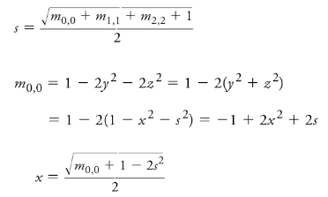
Quaternions
Convert back & forth b/w rotation matricesand quaternions
Quaternions are used to interpolate b/w rotations, and the result is converted to a rotation matrix so as to combine it with other matrices in the display pipeline
Rotation matrix M_{q} to unit quaternion q
//Replace m0,0 with m1,1 and m2,2 for y and z

Slide 60
Quaternions
Interpolation between two 3x3 rotation matrices undefined
Component-wise? You get a squeezing result
Interpolation between two quaternions is well defined
Unit quaternions q₁ and q₂, and parameter u in [0,1]
lerp for linear interpolation (slerp for spherical linear interpolation)
lerp(q₁, q₂, u) = (1-u) q₁ + u q₂
slerp(q₁, q₂, u) = sin(1-ua)/sina q₁ + sin(ua)/sina q₂
where a is the angle b/w q₁ and q₂

Slide 61

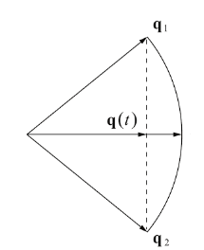
Quaternions
Quaternion Lerp
Problem? Not unit length

Slide 62

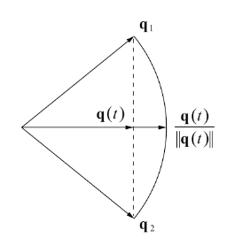
Quaternions
Quaternion Lerp
Unit length ☺
Problem: not trace out the arc at constant speed

Slide 63
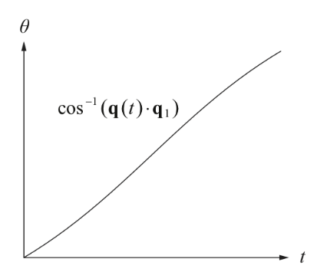
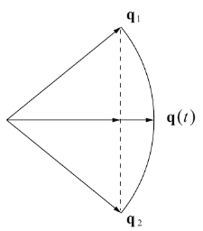
Quaternions
Quaternion Lerp
Problem: not trace out the arc at constant speed
To see this varying-speed problem, observe that arccos changes relatively slow at endpoints (t=0 and 1) and is the fastest when t=0.5
arccos to get the angle
between q(t) and q₁

Slide 64
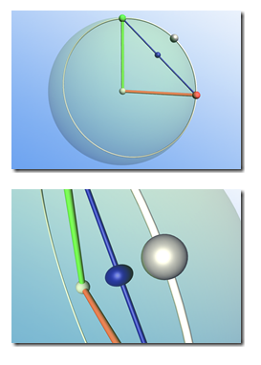
Quaternions
Quaternion Lerp
Problem: not trace out the arc at constant speed
See the problem visually here and there: https://youtu.be/uNHIPVOnt-Y
Blue is traced with quaternion lerp (squeezed compared to white)

Slide 65

Quaternions
Quaternion Slerp
Spherical linear interpolation (slerp) of quaternions
Sweeps through the angle b/w q₁ and q₂ at a constant rate

Slide 66
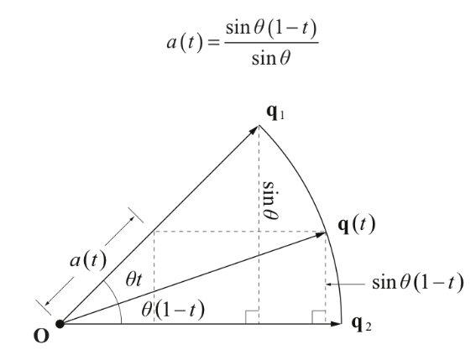
Quaternions
Quaternion Slerp
Spherical linear interpolation (slerp) of quaternions
Sweeps through the angle b/w q₁ and q₂ at a constant rate
a(t) and b(t) are the lengths of the components of q(t) lying along the directions q₁ and q₂
Recall q(t) is unit

Slide 67
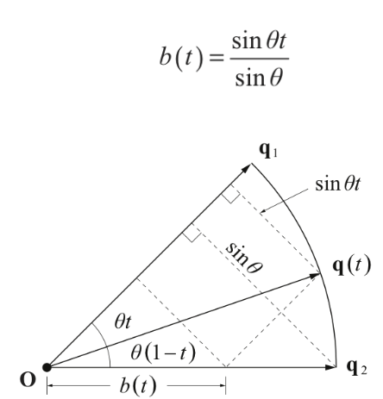
Quaternions
Quaternion Slerp
Spherical linear interpolation (slerp) of quaternions
Sweeps through the angle b/w q₁ and q₂ at a constant rate
a(t) and b(t) are the lengths of the components of q(t) lying along the directions q₁ and q₂
Recall q(t) is unit

Slide 68
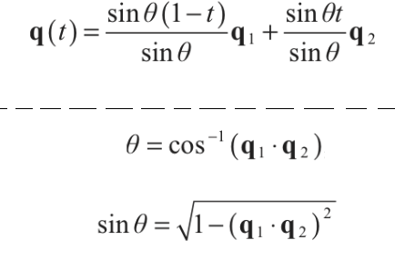
Quaternions
Quaternion Slerp
Spherical linear interpolation (slerp) of quaternions
Sweeps through the angle b/w q₁ and q₂ at a constant rate
Hence we have

Slide 69
Quaternions
Quaternion Slerp
Spherical linear interpolation (slerp) of quaternions
Sweeps through the angle b/w q₁ and q₂ at a constant rate
What we have gives us the white trace and cool interpolation

Slide 70
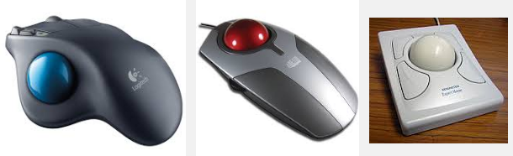
Rotations
Trackball: a cool application of rotation around an axis
Could be done with rotation matrices or quaternions
Here the idea is using a rotation about an arbitrary axis
Application of this hardware into 3D virtual scene navigation

Slide 71
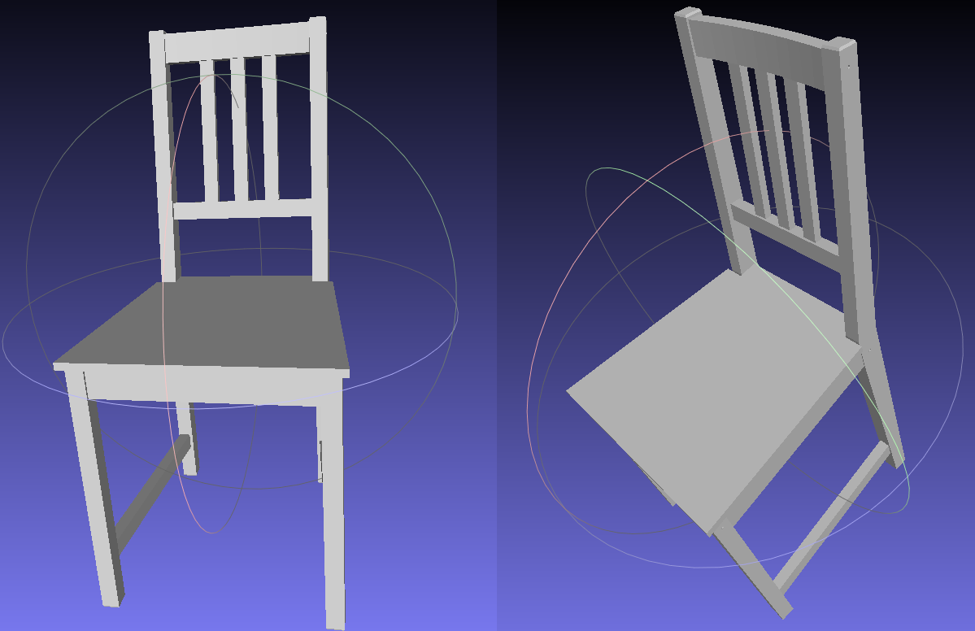
Rotations
Trackball

Slide 72
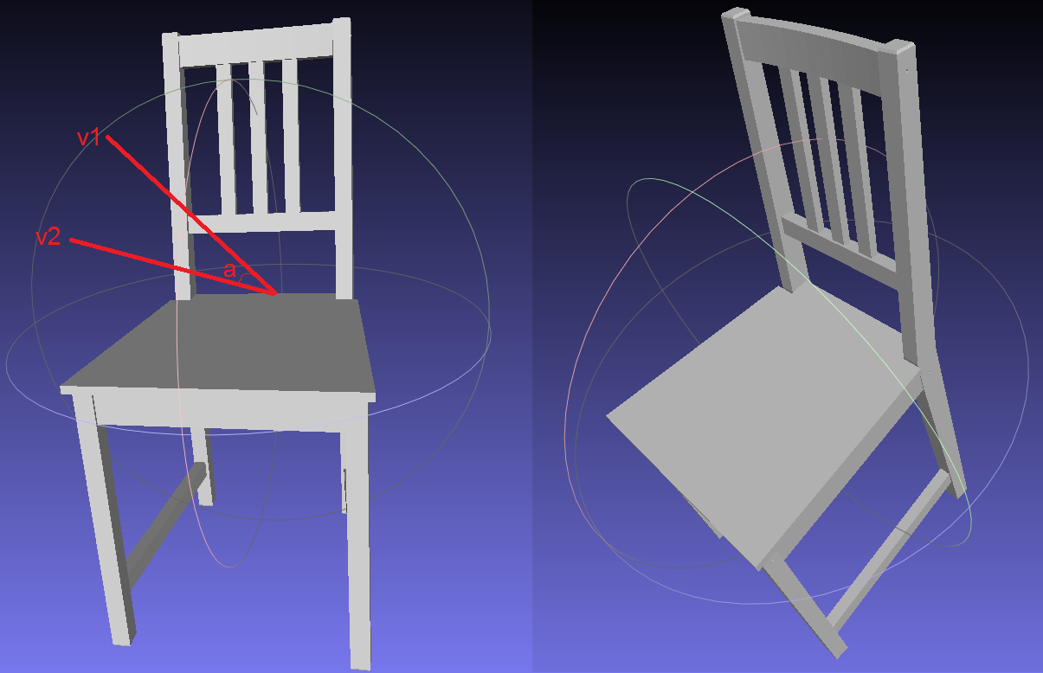
Rotations
Trackball
Click on point v1
Hold the mouse down
Think v1 as a pnt on sphere
Pull v1 to v2
v1 and v2 are unit vectors from sphere center
v3 = v1 x v2 is my arbitrary axis of rotation ☺
Angle a = arccos(v1.v2)
Unit quaternion q = (cos(a/2), sin(a/2)v3)
Same effect w/ rotation mtrx w/ angle a around axis v3

